Slide 1

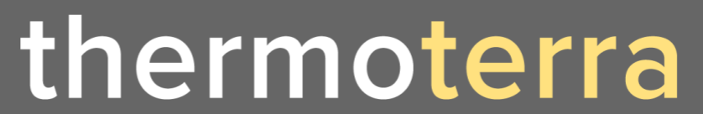
Next Generation Renewable Energy

Slide 2
Wind, solar, geothermal: known and developed renewable energy sources. But untapped energy exists in the air around us: Humidity Power.
ThermoTerra harvests the dormant potential energy in daily humidity fluctuations.
This energy can heat and cool buildings, reducing energy usage for heating and cooling by more than 50%.

Slide 3
The Problem
Buildings represent 30% world energy usage, of which 50% is for heating and cooling.
Legacy energy-intensive HVAC systems are still relied on, despite their energy intensity.
No solution has captured the full potential of natural environmental humidity fluctuations.
CONFIDENTIAL

Slide 4
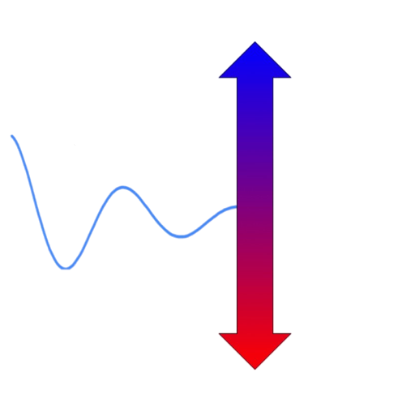
The HumidityPower Solution
Evaporative cooling
When water evaporates it absorbs energy, creating a cooling effect. This is why sweating cools.
The inverse is also true. When water vapour is absorbed, heat is generated.
At night, humidity is higher, while during the day, humidity lowers.
ThermoTerra harvests the potential energy lying dormant in these natural fluctuations in humidity.
Powered by
humidity fluctuation
Absorption heating
CONFIDENTIAL

Slide 5
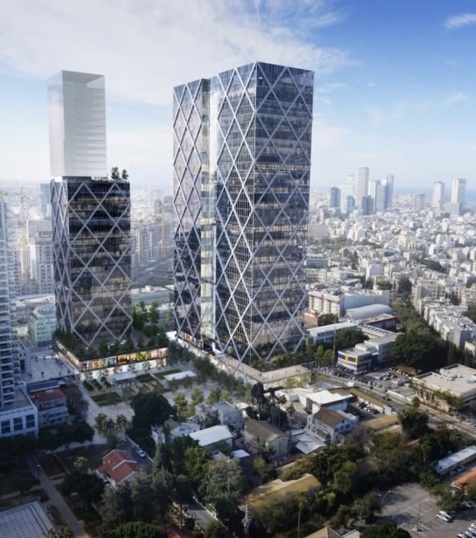
ThermoTerra’s SmartWall
Like double glazing, ventilated facades passively trap external air, creating hot or cold air pockets, controlling the building’s temperature.
ThermoTerra’s “SmartWall” is fitted directly onto building exteriors, like existing ventilated facades.
SmartWall “charges” at night, absorbing water when ambient humidity is high.
During the day, stored water evaporates, which absorbs energy and cools the building.
CONFIDENTIAL
5

Slide 6


Deliveries
How does a SmartWall work?
By adding a cooled layer to building’s external wall, SmartWall ensures that a building’s heating and cooling costs are vastly reduced.
Without SmartWall
With SmartWall
30° C
external temperature
30° C
external temperature
30° C
30° C
30° C
external wall
25° C
SmartWall
30° C
External wall matches air temperature
25° C
SmartWall reduces wall temperature
20° C
internal temperature
(high-use HVAC)
20° C
internal temperature
(low-use HVAC)
20° C
20° C
X
Watts of power
½ X
Watts of power
CONFIDENTIAL

Slide 7

Deliveries
How does SmartWall cool during the day?
1
Daytime Cooling
SmartWall brings in warm dry air…
…cold air is blown away
During the day in hot temperatures, SmartWall’s IoT-enabled fans bring in the ambient warm and dry air.
Humidity stored in SmartWall evaporates into the dry air, absorbing energy and cooling the air.
The cold air flows along the building wall, absorbing energy and cooling the building.
The cold air is then blown away.
1
4
1
External
Wall
2
Building Interior
2
Building Exterior
3
3
…cold air absorbs heat, cooling the building wall…
4
2
… as warm dry air passes through, the stored water evaporates, absorbing energy, and cooling the air…
CONFIDENTIAL

Slide 8
Deliveries
How does SmartWall charge & heat at night?
2A
Nightime Heating & Charging
SmartWall brings in cold, humid air …
…warm air is blown away
At night in cold temperatures, SmartWall’s IoT-enabled fans bring in the ambient cold and humid air.
ThermoTerra’s uniquely treated material absorbs moisture, allowing the SmartWall to “charge”, holding potential energy in the form of absorbed humidity.
Water vapour absorption releases heat, warming the air flowing along the building wall, heating the building.
The dry and warm air is blown away into the night.
1
4
1
External
Wall
2
Building Interior
2
Building Exterior
3
Absorption releases heat, heating the building’s wall
3
2
4
…as humid air passes through, water is absorbed by SmartWall, “charging” it.
CONFIDENTIAL

Slide 9
Deliveries
How does SmartWall charge & cool at night?
2B
Nightime Cooling & Charging
…warm air is blown away
SmartWall brings in cold, humid air…
At night in warm temperatures, SmartWall’s IoT-enabled fans bring in the ambient cold and humid air.
The cold air passes along the building’s external wall, cooling the building (and warming the air).
ThermoTerra’s uniquely treated material absorbs moisture, allowing the SmartWall to “charge”, holding potential energy in the form of absorbed humidity.
The dry air, which has been warmed by the absorption process, is blown away into the night.
4
1
1
External
Wall
2
Building Interior
3
Building Exterior
2
3
…cold air absorbs heat, cooling the building wall…
3
4
… SmartWall absorbs moisture, charging itself…
CONFIDENTIAL

Slide 10


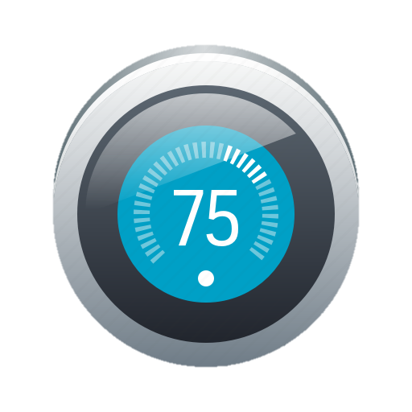

Deliveries
ThermoTerra saves more energy than existing technologies
Existing Technologies
ThermoTerra’s Energy Savings
Energy Recovery
Ventilation
Free-Cooling
20%
20%
20%
<50%
N/A
Smart
Thermostats
Active
Insulation
15%
<50%
30%
Fans
11%
Key
30%
% Saving
(Cooling)
8%
N/A
% Saving
(Heating)
CONFIDENTIAL

Slide 11
Our business model
ThermoTerra Partners market, manufacture, sell and install our products to building owners, leveraging existing distribution and marketing networks for a fast route to market, while lowering costs for ThermoTerra.
End-Users
ThermoTerra Partners
Consultants / Distributors⁽¹⁾
Installation
Fee
Cutting-edge product to produce and sell
Percentage of
Installation Fee
Individual Consumers
& Building Owners
Money saved on ongoing energy costs
Building Developers
Licence Fee
Savings justify higher rental / sale prices
Maintenance Fee
Note: (1) e.g. architectural firms, manufactures or consultants paid to manage building projects, including relationships with building developers
CONFIDENTIAL

Slide 12
How do we make revenue?
Who pays ThermoTerra?
Individual Consumer
Building Owner
Consultant / Distributors
Building Developer
Pre-Sale
License Fee
N/A
N/A
Potential to charge “authorized distributers”
Potential to charge “authorized distributers”
At-Sale
Installation Fee
N/A
Long-term potential for direct sales to building owners
  ✓
  ✓
Installation Fee
Installation Fee
Post-Sale
Maintenance Fee
Potential charge to consumers for control / use
  ✓
N/A
N/A
Maintenance Fee
CONFIDENTIAL

Slide 13
Deliveries
Value proposition for end-customers
Worked example of ThermoTerra’s value proposition for a building owner
150 KWh / m²
Energy consumption for heating & cooling
~$40
Production cost per m2
30%
ThermoTerra fee
$0.30
Price per KWh
~50%
Partner margin and installation costs
50%
ThermoTerra saving
$22.50
Net Savings / m²
⁽¹⁾
~40%
5-Year Customer Return on Investment (ROI)
$80.0
Installation Price / m²
Note: (1) Average renovation cost for deep energy renovations is €580 / m^{2,} i.e. ThermoTerra are good value for money!
CONFIDENTIAL

Slide 14
Milestones & Go-to-Market
Additional Team Members
Market-Ready Product
Commercial Expansion Year
Progress to Date
New Products
Research
Patent (2017)
Pilot (2018)
Product Integration
(2019)
First POC (2020)
2020
2021
2022
2023
2024
Commercialisation
Secure Funding
& First Partner
Develop Products with End-User
First Sales,
Partners 2 & 3
Continued Expansion
Own Manufacturing Process?
CONFIDENTIAL

Slide 15
Market Analysis
$900 MM p/a
Given the size of the construction industry, even a small market share of the relevant geographical ventilated facade markets leads to large revenues.
TAM
Global Facade Market
=
$273 Bn p/a
SAM
US, EU & MENA
Ventilated Facades
=
$90 Bn p/a
SOM
1% Market Share
=
Source: Facade Systems Market Analysis, Industry Forecast 2018-2023
CONFIDENTIAL

Slide 16

Our Products
SmartWindow
Humidity Control
Beyond the SmartWall and SmartScreen, several more products are envisioned using the patented HumidityPower technology.
SmartWall / SmartScreen
SmartWall and SmartScreen are ThermoTerra’s initial products, to be installed on refurbs or new builds.
Time to Market:
2021
The SmartWindow will use humidity power within the air in double-glazed windows
Time to Market:
2023
Air within can be controlled, facilitating ambient temperature control (i.e. preference-based humidity control)
Time to Market:
2025
CONFIDENTIAL

Slide 17
Financial Analysis
ThermoTerra’s partnership-based model means rapid revenue growth on a low cost base.
Annual Revenue Forecast
$000s
$20 MM
Year 5 Revenue
19,937
Leveraging partners’ existing client relationships supports a rapid revenue scale-up
11,396
80%+
Year 5 EBITDA Margin
5,060
1,838
High profitability driven by low costs from partner-based advertising, production and distribution
448
Year
0
Year
1
Year
2
Year
3
Year
4
Year
5
CONFIDENTIAL

Slide 18
Deliveries
Short-term Revenue Predictions
A “bottom up” approach for revenue based on a limited number of partners
10
Partners
6
Projects per
Partner p/a
15,000m²
Average Project Size
$14 / m²
Average Revenue⁽¹⁾
$20 MM
Year 5 ThermoTerra Revenue Forecast
Note: (1) Average revenue comprises installation fee, on-going fee, and license fee
CONFIDENTIAL

Slide 19
Deliveries
Financial Model Snapshot (1/2)
Partnership model assumptions
CONFIDENTIAL

Slide 20
Deliveries
Financial Model Snapshot (2/2)
Income statement highlights
CONFIDENTIAL

Slide 21


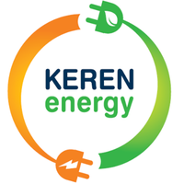

Our Backers & Partners:
Previous Funding & Assets
Industry Partners
2
Patents Granted
Ongoing talks with WeWork
Ongoing talks with Abraham Hostels (top Israeli hotel chain)
$160,000
Israeli Ministry of Infrastructure (Grant)
Signed LOI with Alumeshet (top Israeli construction firm)
Ongoing talks with major German group (global materials producers)
$100,000
Own funds Contributed
Signed LOI with AUS (Israeli sustainable architects)
Signed LOI with Keren Energy, (global energy efficiency firm)
CONFIDENTIAL

Slide 22


Meet the founders
Eviatar Tron
Co-Founder & CEO
Dror Zchori
Co-Founder & CTO
Seasoned systems and integration engineer
Background in cleantech and automotive systems.
Founder of GREEK Grass Roots Cleantech
Co-Founder of Gezer Environmental Tech Thinktank
BSc in Software, MSc in mech, eng.
Expert in environmental studies and engineering
Over 20 years experience in renewable energy, green buildings, water recycling and permaculture
Background in in biotechnology, agriculture and as a trained mechanical engineer.
CONFIDENTIAL

Slide 23

Meet the team
Scientific Advisory
Strategy & Finance
Jeremy Rutman
Research & Legal
Jonathan Nathan
Research
Ely Sandler
Strategy
Chris Lyle
Finance
Experimental physics expert (PhD from the Technion) and startup experience as a patent attorney and programmer
Physicist with experience in thermodynamics of humidity transfer, data science and machine learning
Previously advisor for Morgan Stanley clients on economic policy with a background in finance and strategy
Corporate finance and infra-structure background having worked throughout Morgan Stanley’s banking operations
CONFIDENTIAL

Slide 24
Thank You
Please get in touch
Eviatar Tron
eviatar@humiditypower.com

